Slide 1



Airline Product Management Working Group
Introduction to Product Rules
G. Baues AirFrance/KLM

Slide 2
Agenda
Business problem
Rule Requirements
Examples
Notes:
As consequence we need a full flexible and extensible framework which nevertheless can be automated in terms of processing on a large industry scale as there are n:m agreeements in place
As an airline I have 1:n partner agreements and I am part
Bilateral agreements between Seller, Retailer, Supplier as well as Delivery providers
Additional principles
Full freedom on the nature and choice of products being part of such an agreement. The agreement can change ovetime wrt to products as well as the information exchanged
There will be n:m exchange channels for each participant in the ecosystem the number of bilateral partners is not the same for anyone nor the nature of the partners

Slide 3

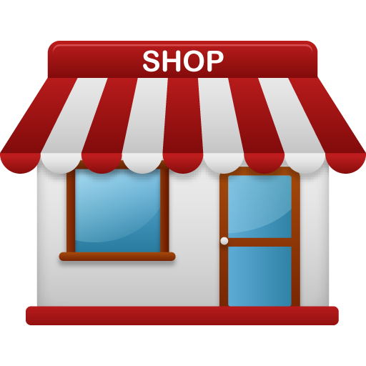


Business problem
Create the full retail view of all my suppliers' products in my product management system
Coorp A
Coorp B
Retail agreement
Shop A retails
Shop B retails
Notes:
As consequence we need a full flexible and extensible framework which nevertheless can be automated in terms of processing on a large industry scale as there are n:m agreeements in place
As an airline I have 1:n partner agreements and I am part
Exchange of product information for retailing purposes ( presentation, search, offer construction )
In order to make that work we need a common understanding of what the exchanged information means

Slide 4
Business problem
Optimize offer creation process incl. product assortment and pricing
All products from suppliers accessible in my product management system, if selected for an offer, require at least one round trip to the supplier to obtain one or more supplier offer(s) for those products. As retailer I have no visibility on the supplier's stock levels nor pricing
→ Minimize the required calls
Today the base assumption is that we do not know neither any other rules/strategies from the supplier directly influencing the possibility to include a product in an offer or not and thus obtain a valid offer : We are fishing in the dark . By having the supplier catalog i.e. suppliers product information ( retail view only! We do not see any stock ) available at the retailer side we are already in a better position ( this wasn’t known either before except some very coarse-grained information ). This is necessary but not sufficient. Often, I will get back a negative response or a response which is very far away from what I was looking for mostly also not even knowing why I didn't get an offer.
The Business requirement is to enable optimized product assortment by excluding as soon as possible any supplier products from the assortment process which would yield a negative / no offer from the supplier.
The answer from the supplier is conditioned by business rules on his side which will be executed at the offer request time but that is too late as we already had to do the request. Thus, this lead’s to very bad look to book ratios from the supplier's point of view and bad offer performance from the retailer point of view.
The requirement is to be able to convey such business rules together with the product information itself to the retailer enabling the retailer to control the product assortment in accordance with the supplier's business strategy / rules etc ..
The following outlines the requirements for describing such rules as well as their link to the product information and taxonomy
Notes:
As consequence we need a full flexible and extensible framework which nevertheless can be automated in terms of processing on a large industry scale as there are n:m agreeements in place
As an airline I have 1:n partner agreements and I am part

